Slide 1

TURBIDITY PREDICTION FOR industrial cleaning processes
IE7275 Data Mining in Engineering
Prof. SAGAR Kamarthi
GROUP 2
MONISHA PRAKASH
WEI DU

Slide 2
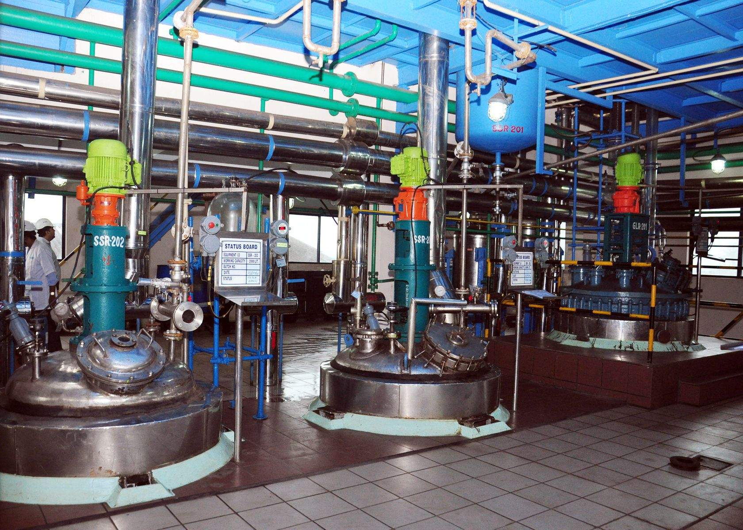
PROBLEM DESCRIPTION
The goal of this project is to predict measures of cleanliness (turbidity) to improve efficiency in industrial cleaning processes.
Industrial cleaning standards are strict, especially in food and beverage industry.
The cleaning processes requires substantial amount of resources : Water, caustic acid , soda.
Turbidity (amount of suspended particles) is an indicator of efficiency of cleaning process
Depending on this “expected level” of turbidity a cleaning station operator can extend or shorten the cleaning process.
This conserves water and cleaning resources while ensuring high cleaning standards

Slide 3
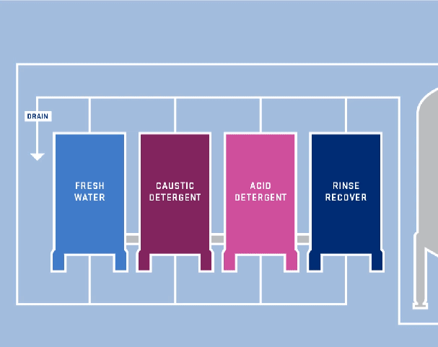
CLEANING PROCESS
Clean in place ( CIP) processes is a method of cleaning production objects without disassembly. In the station, the cleaning material is stored in tanks connected to food and beverage production objects through different outlet and return pipeline
Pre-rinse phase: Rinse water is pushed into the cleaning object
Caustic phase: Caustic soda is pushed into the cleaning object
Intermediate rinse phase: Clean or rinse water is pushed into the object
Acid phase: Nitric acid is pushed into the cleaning object
Final rinse phase: Clean water is pushed into the object

Slide 4
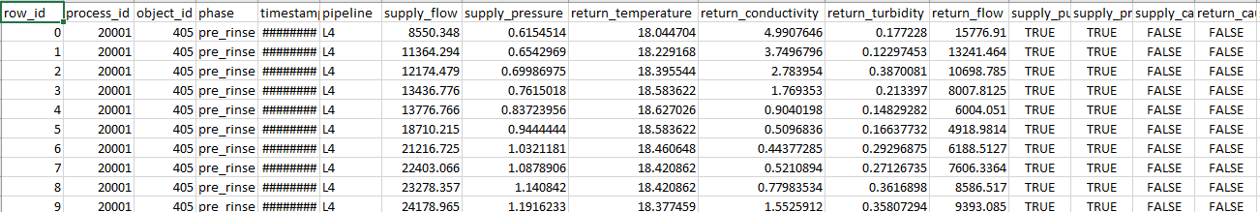
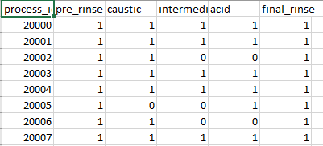
DATASET DESCRIPTION
Left join on recipe to gather data on standard cleaning procedures
Median measurements for each process ID by standard procedures
Removing outliers for turbidity values
Retain measurement details only if indicated as ‘TRUE’

Slide 5
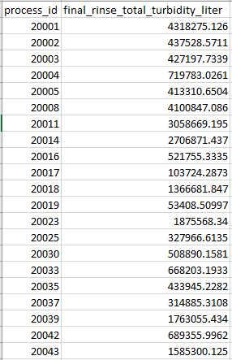
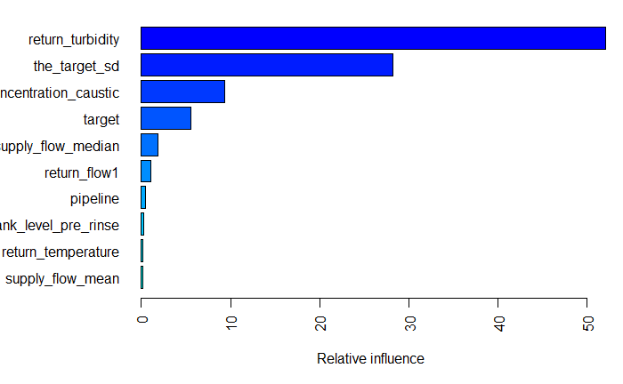
MODELS USED
RANDOM FOREST REGRESSION WITH RANGER
BOOSTED RANDOM FOREST REGRESSION
BOOSTED RANDOM FOREST WITH TUNING
FINAL PREDICTION SAMPLE

Slide 6
PERFORMANCE EVALUATION METRICS

